Slide 1


#LifeKoKaroLift
PG Diploma in ML/AI
1
22-05-2022

Slide 2


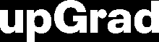

Course : Machine Learning Session On : DL Instructor : Siddhesh Gunjal
EEditdit MasterMaster texttext ststylyleses
22-05-2022
2

Slide 3
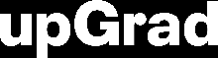

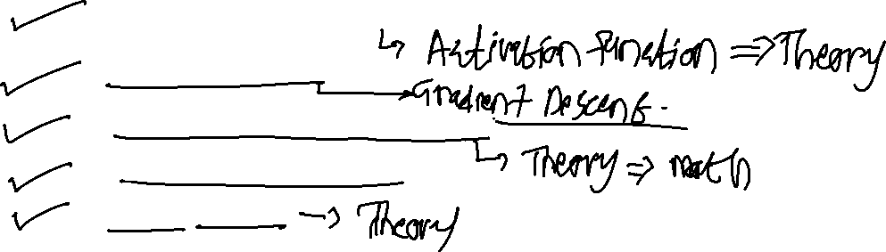
KEY TOPICS
Perceptron Feed Forward
Backpropagation Convolutional neural networks
Recurrent neural networks
GRU & LSTM
22-05-2022
3

Slide 4
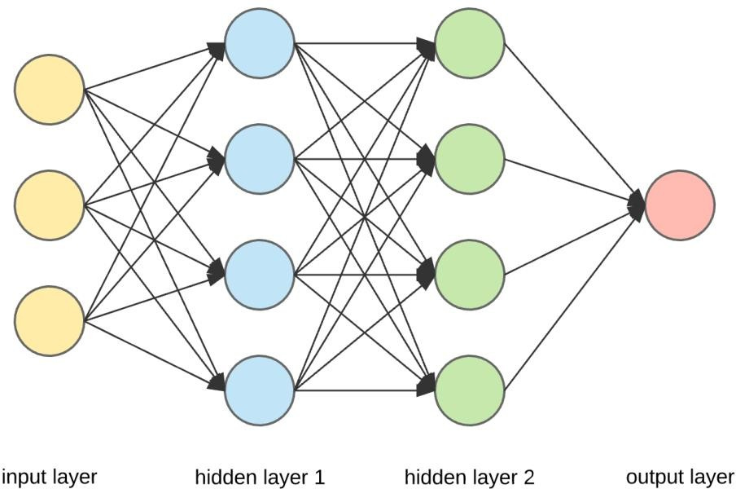
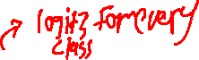
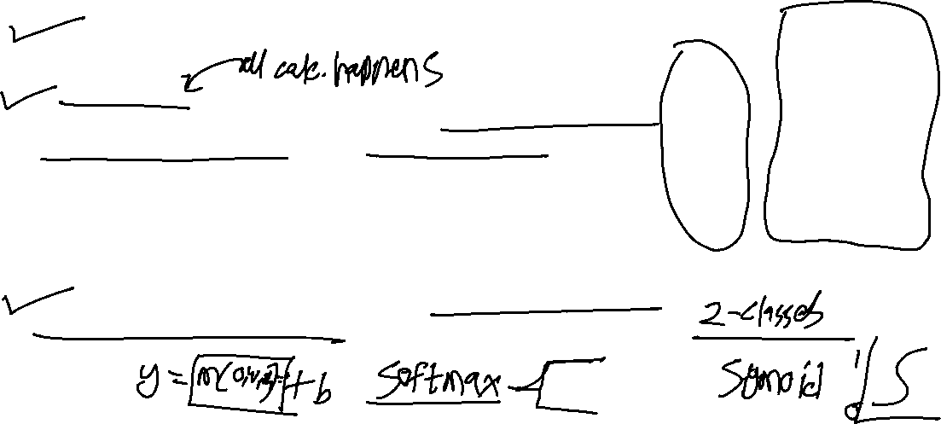
The Layers of a Neural Network
3 types of layers in neural network:
Input layer — It is used to pass in our input(an image, text or any suitable type of data for NN).
Hidden Layer — These are the layers in between the input and output layers.These layers are responsible for learning the mapping between input and output. (i.e. in the dog and cat gif above, the hidden layers are the ones responsible to learn that the dog picture is linked to the name dog, and it does this through a series of matrix multiplications and mathematical transformations to learn these mappings).
Output Layer — This layer is responsible for giving us the output of the NN given our inputs.
4
22-05-2022

Slide 5
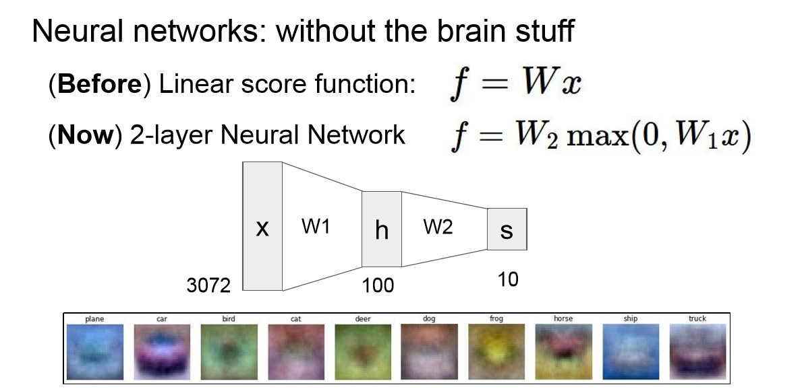
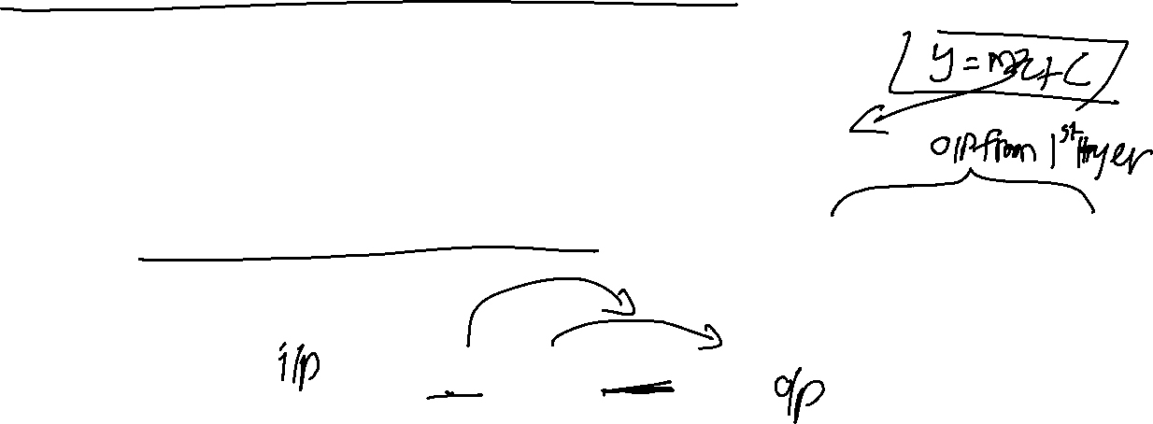
Why we use Activation functions

Slide 6
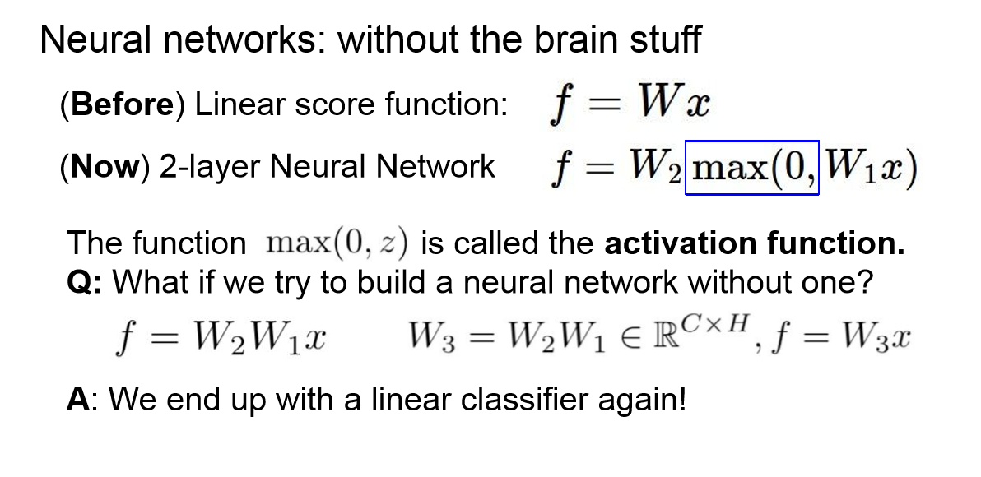
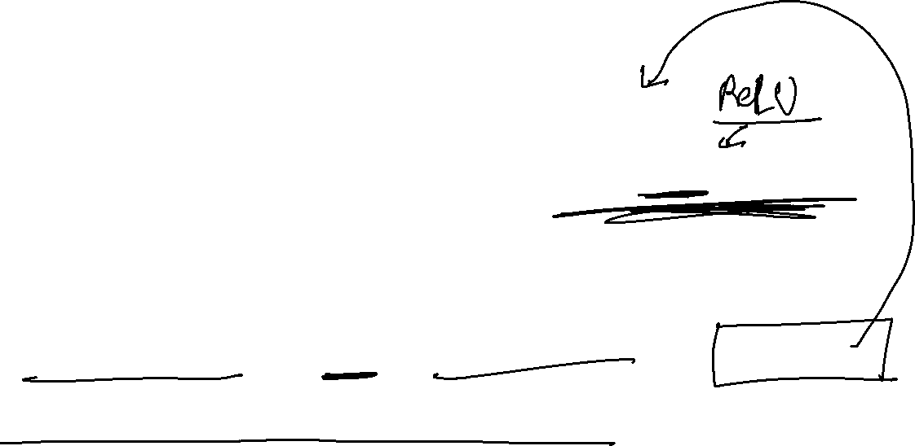
Why we use Activation functions

Slide 7
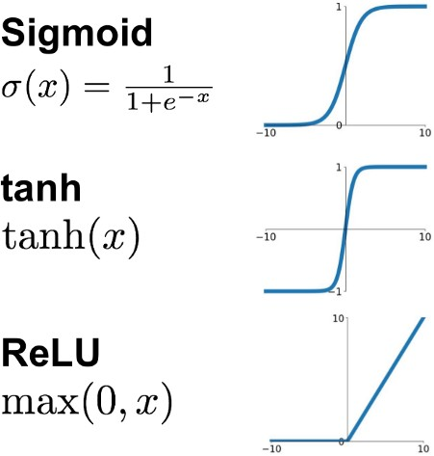
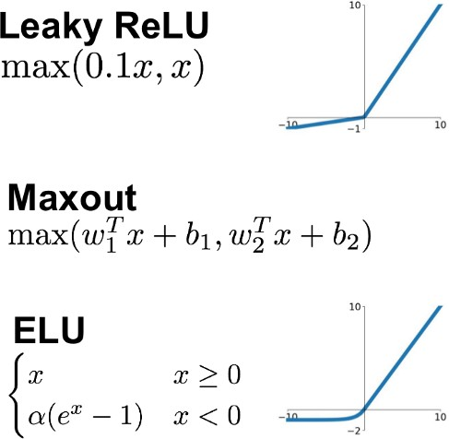
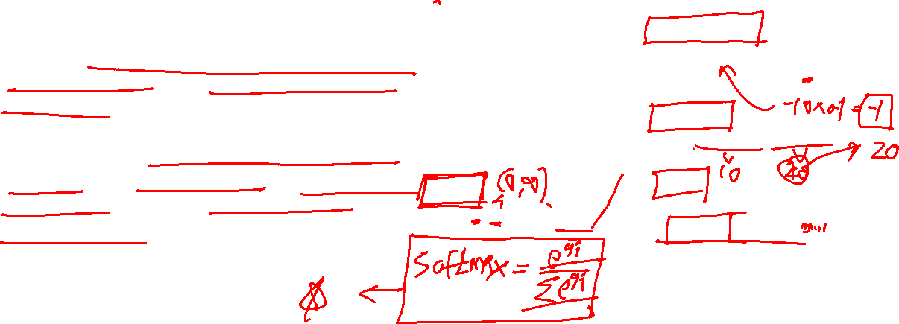
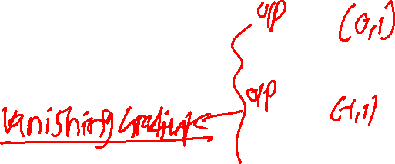
Why we use Activation functions
Activation functions are really important for a Artificial Neural Network to learn and make sense Non-linear complex functional mappings between the inputs and response variable.
They introduce non-linear properties to our Network. Their main purpose is to convert a input signal of a node in a A-NN to an output signal. That output signal now is used as a input in the next layer in the stack.
https://ai.stackexchange.com/questions/5493/what-is-the-purpose-of-an-activation-function-in-neural-networks
7
22-05-2022

Slide 8
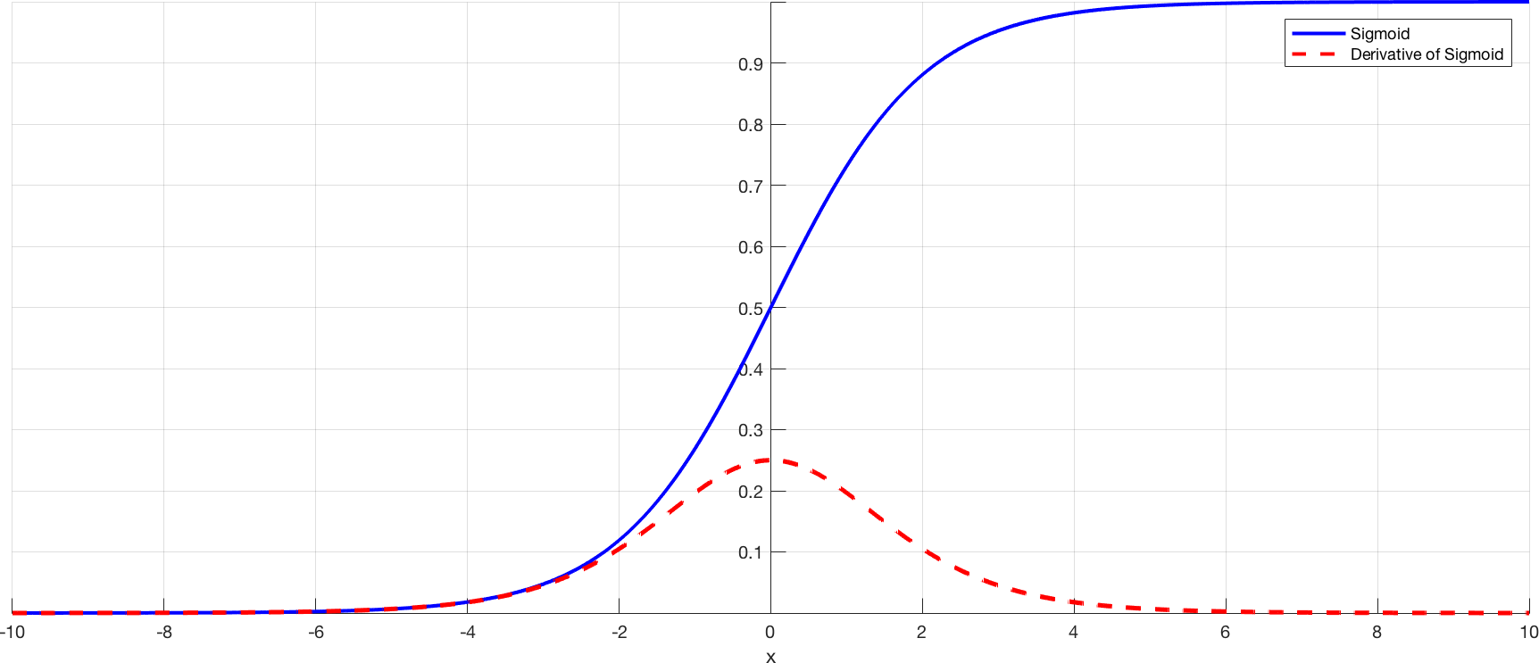
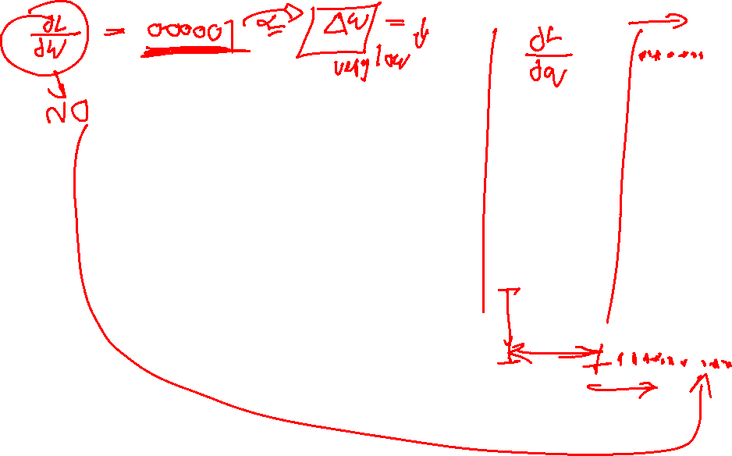
Problem of Vanishing Gradient

Slide 9

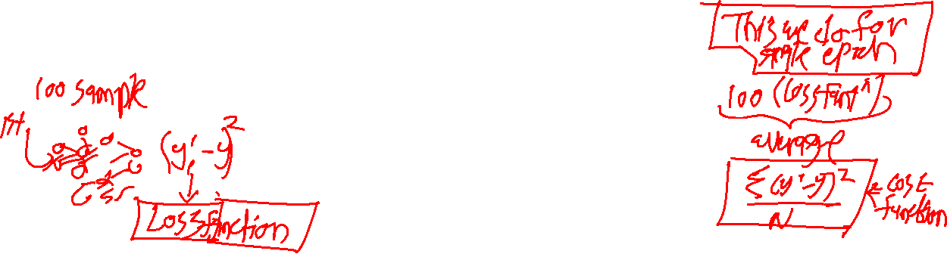
why can’t we do it without activating the input signal
A linear equation is easy to solve but they are limited in their complexity and have less power to learn complex functional mappings from data. A Neural Network without Activation function would simply be a Linear regression Model, which has limited power and does not performs good most of the times.
That is why we use Artificial Neural network techniques such as Deep learning to make sense of something complicated ,high dimensional, non-linear -big datasets, where the model has lots and lots of hidden layers in between and has a very complicated architecture which helps us to make sense and extract knowledge form such complicated big datasets.
https://towardsdatascience.com/activation-functions-neural-networks-1cbd9f8d91d6
9
22-05-2022

Slide 10
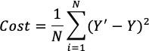
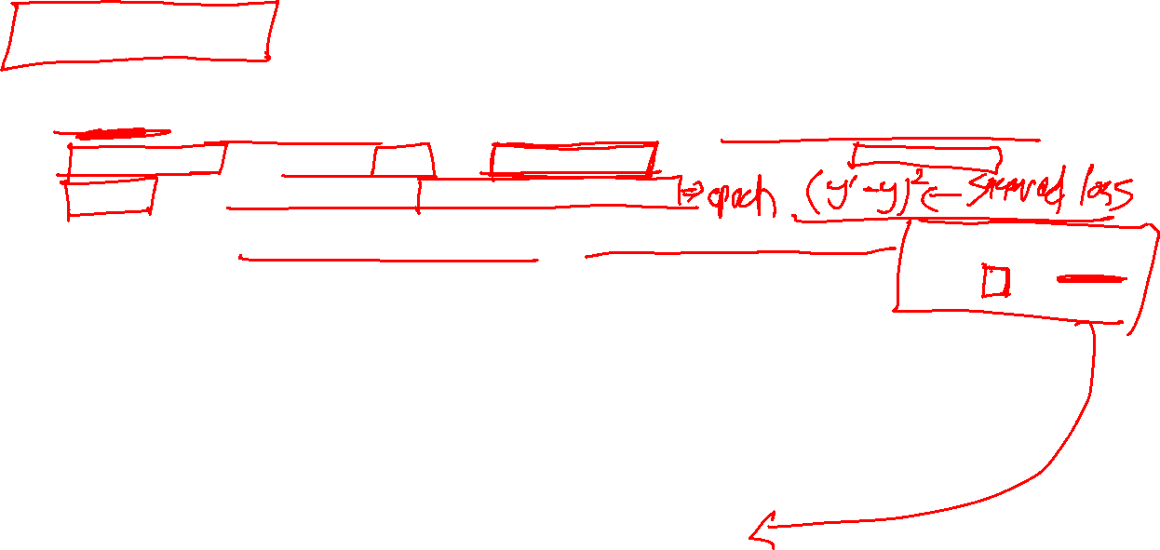
Cost Function
A Cost Function/Loss Function evaluates the performance of our Machine Learning Algorithm. The Loss function computes the error for a single training example while the Cost function is the average of the loss functions for all the training examples.
The goal of any Learning Algorithm is to minimize the Cost Function.
lower error between the actual and the predicted values signifies that the algorithm has done a
good job in learning.
A common measure of the discrepancy between the two values is the ”Cross-entropy”
10
22-05-2022

Slide 11
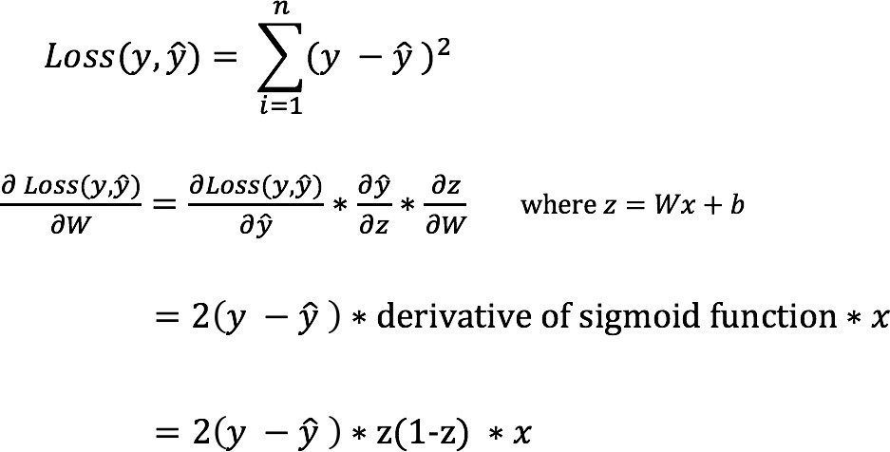
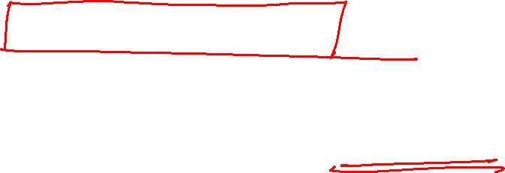
Backward Propagation
we can’t directly calculate the derivative of the loss function with respect to the weights and biases because the equation of the loss function does not contain the weights and biases. Therefore, we need the chain rule to help us calculate it.
22-05-2022

Slide 12
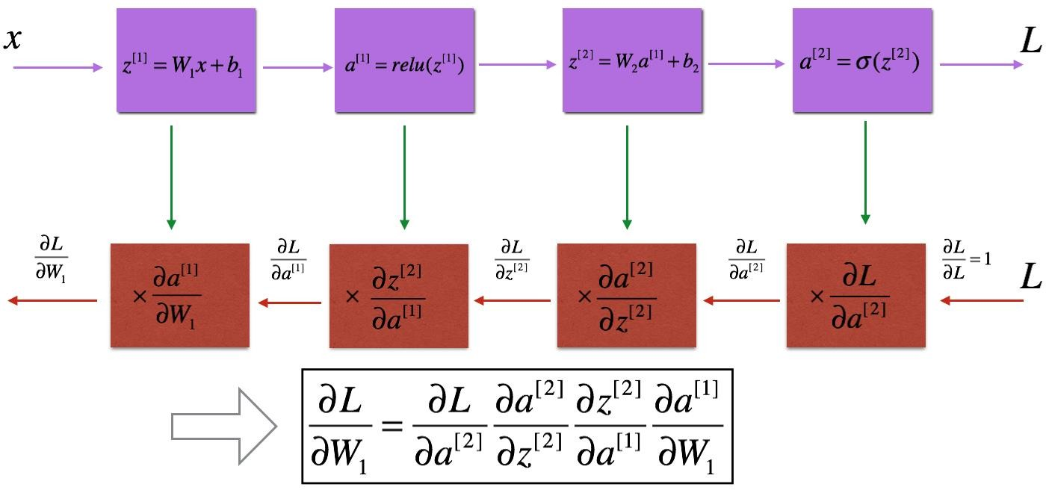
Backward Propagation
We know that propagation is used to calculate the gradient of the loss function with respect
to the parameters.
12
22-05-2022

Slide 13
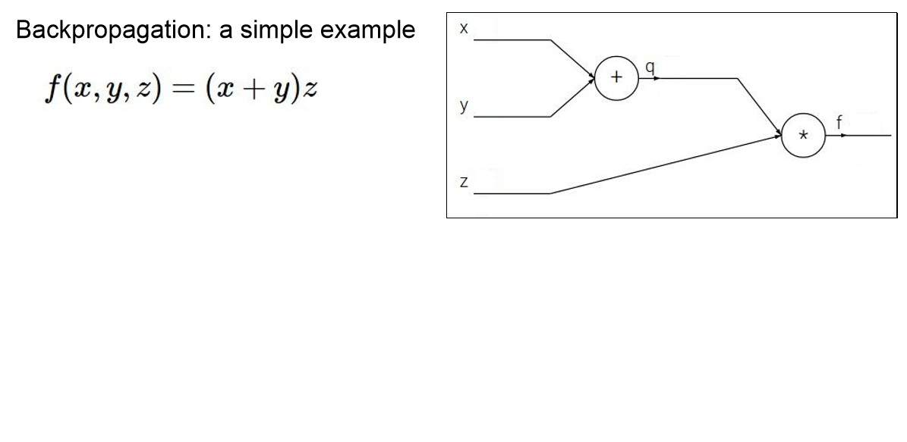
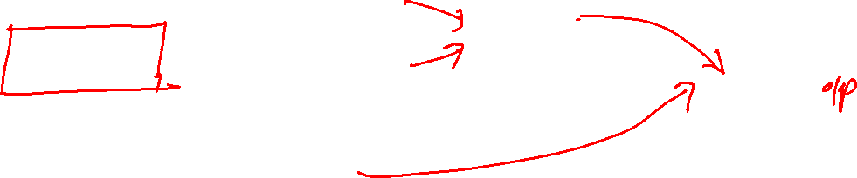
Backward Propagation

Slide 14
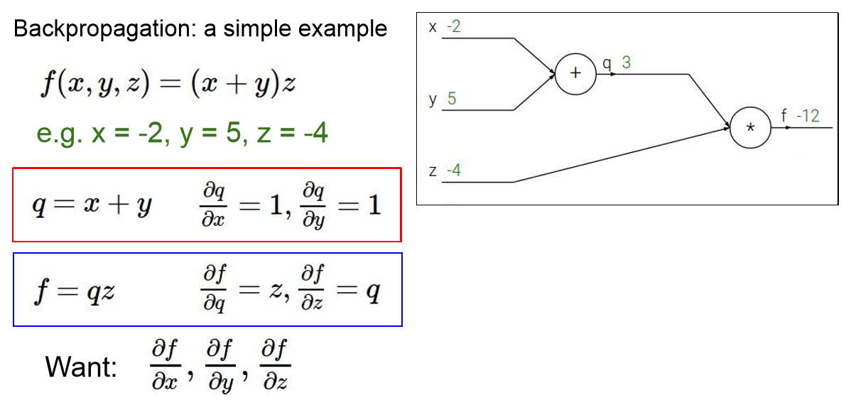
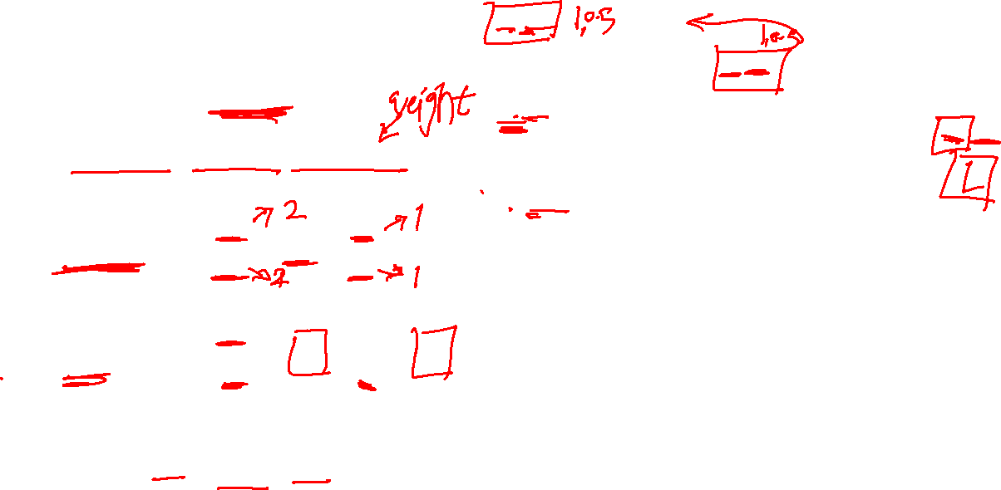
Backward Propagation

Slide 15
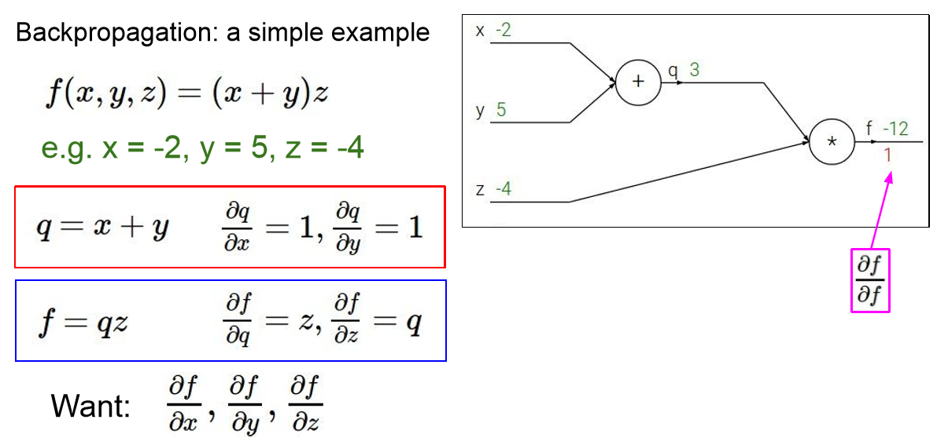

Backward Propagation

Slide 16
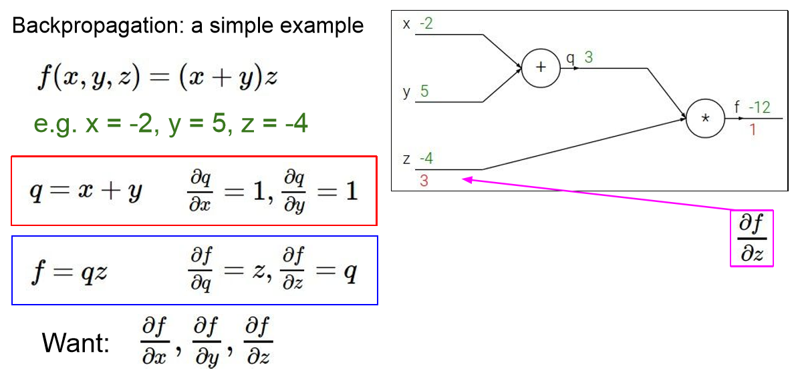
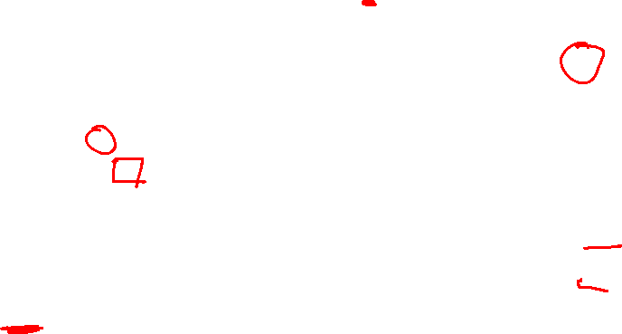
Backward Propagation

Slide 17
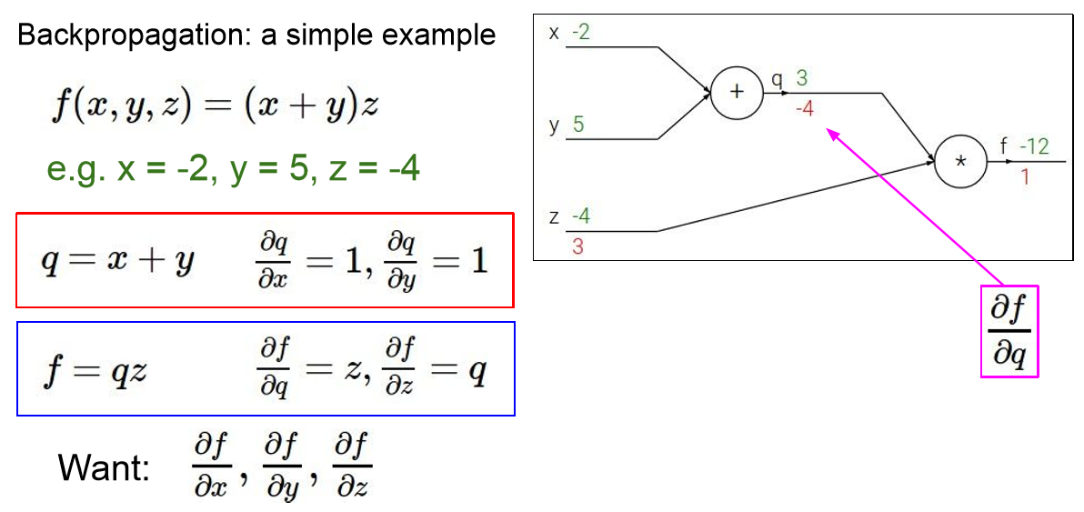
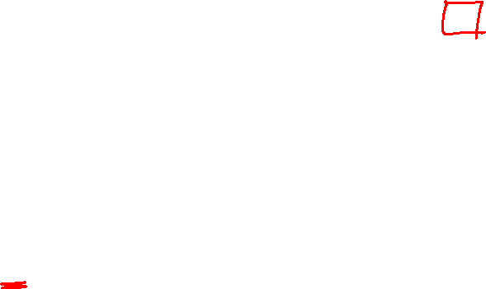
Backward Propagation

Slide 18
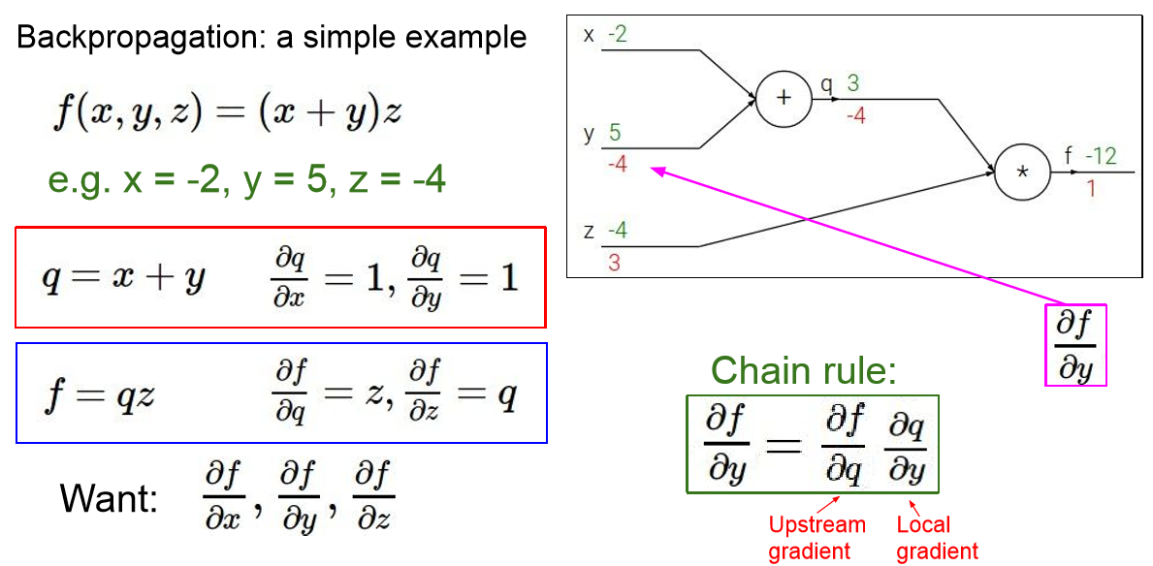
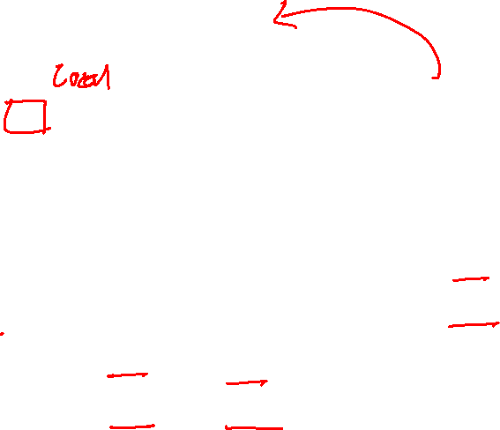
Backward Propagation

Slide 19
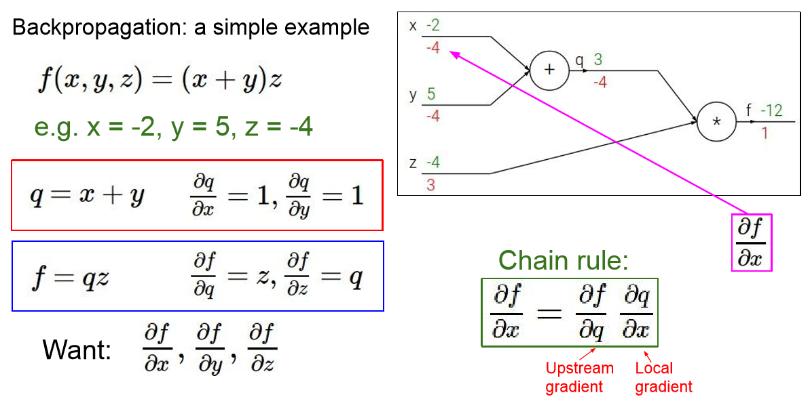
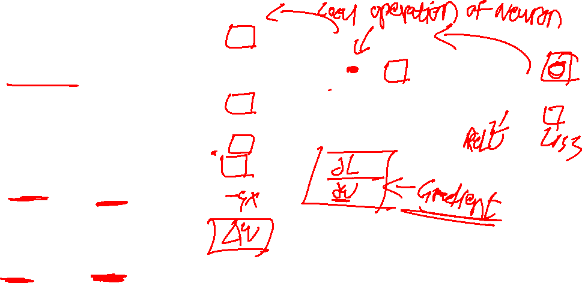
Backward Propagation

Slide 20
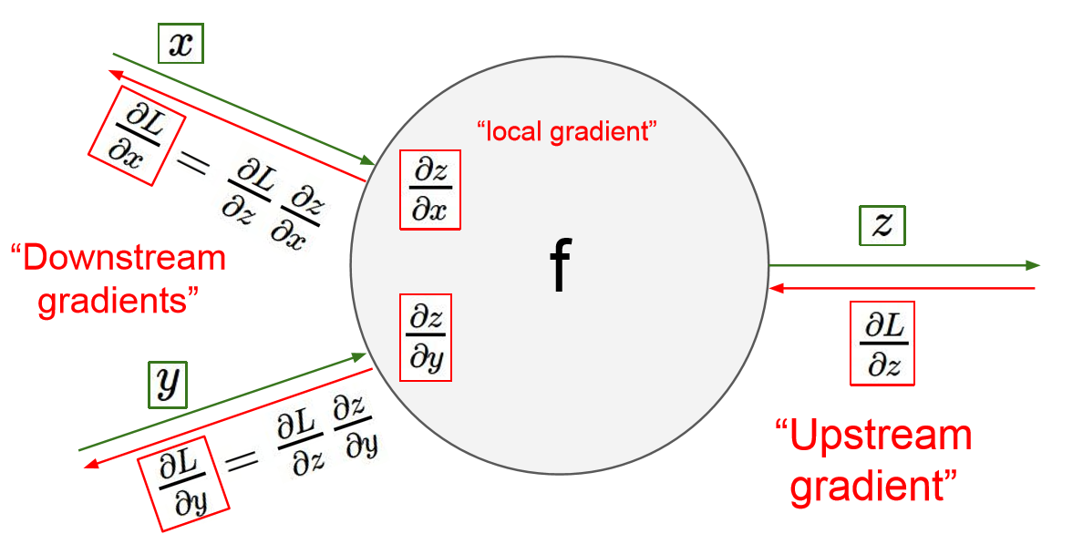
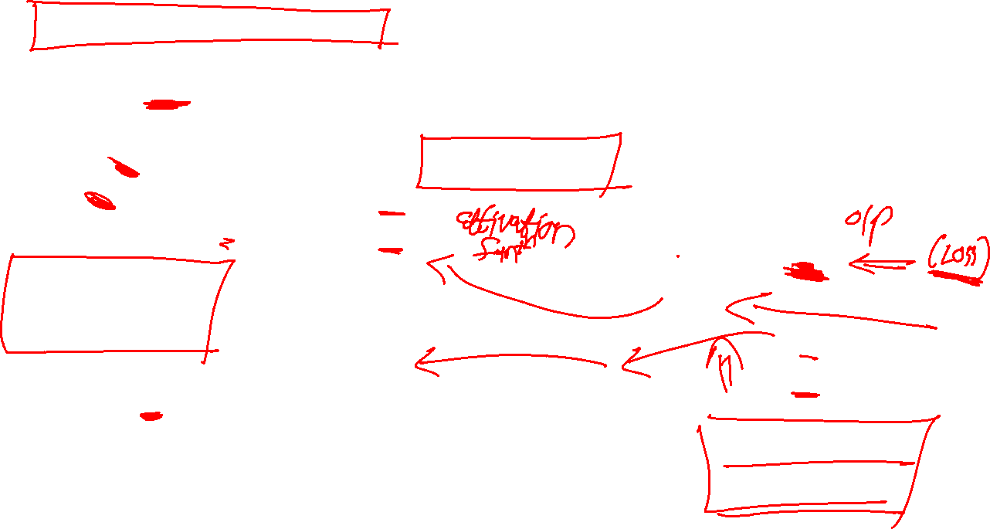
Backward Propagation

Slide 21
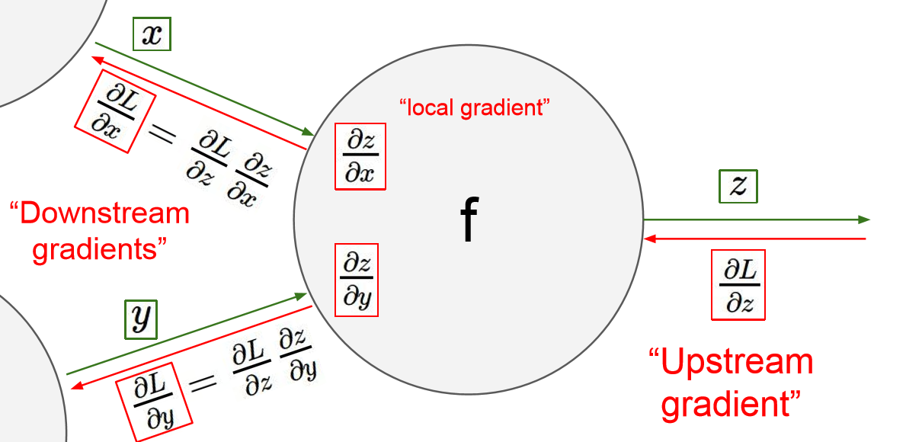
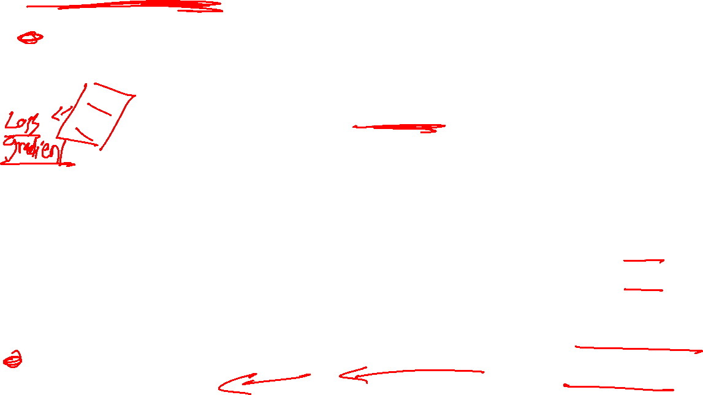
Backward Propagation

Slide 22
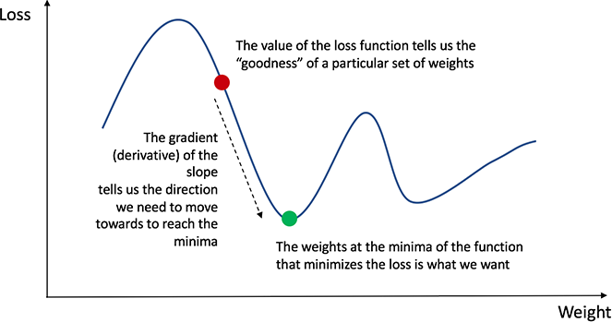
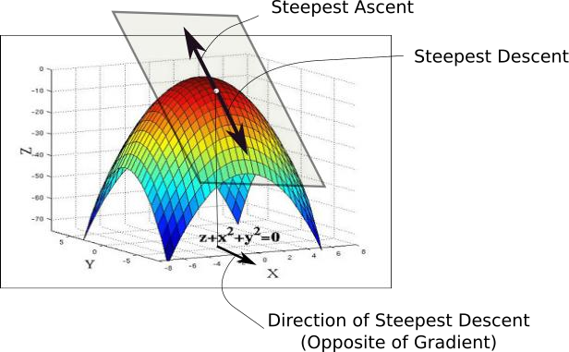
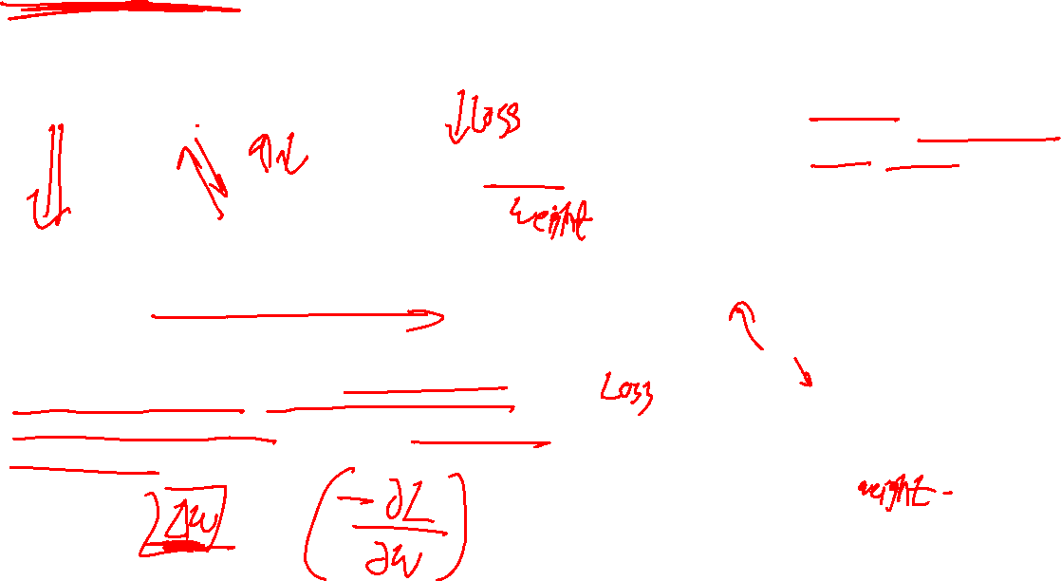
Gradient Descent
While the direction of the gradient tells us which direction has the steepest ascent, it's magnitude tells us how steep the steepest ascent/descent is. So, at the minima, where the contour is almost flat, you would expect the gradient to be almost zero. In fact, it's precisely zero for the point of minima.
Gradient descent is an optimization algorithm used to minimize some function by iteratively moving in the direction of steepest descent as defined by the negative of the gradient
22
22-05-2022

Slide 23
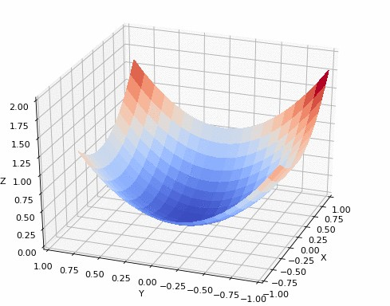
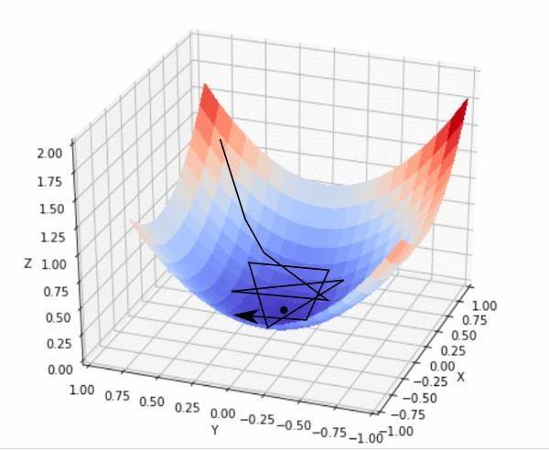
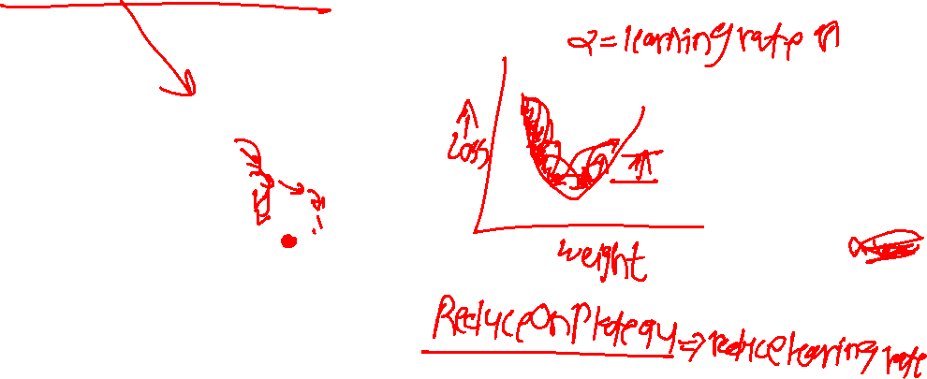
Gradient Descent
In practice, we might never exactly reach the minima, but we keep oscillating in a flat region in close vicinity of the minima. As we oscillate our this region, the loss is almost the minimum we can achieve, and doesn't change much as we just keep bouncing around the actual minimum.
Often, we stop our iterations when the loss values haven't improved in a pre-decided number, say, 10, or 20 iterations. When such a thing happens, we say our training has converged, or convergence has taken place.
23
22-05-2022

Slide 24
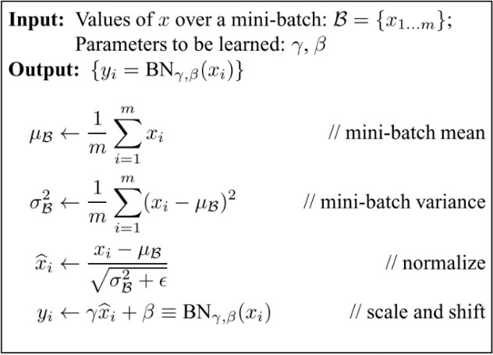
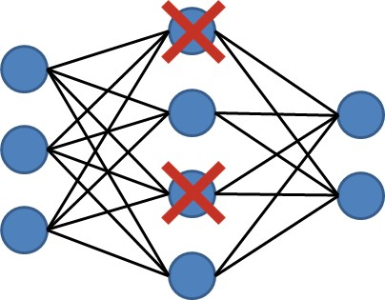
Dropout & Batch Normalization
Dropout is a regularization technique. On each iteration, we randomly shut down some neurons (units) on each
layer and don’t use those neurons in both forward propagation and back-propagation. Since the units that will be dropped out on each iteration will be random, the learning algorithm will have no idea which neurons will be shut down on every iteration; therefore, force the learning algorithm to spread out the weights and not focus on some specific features (units)
In Batch Normalization We normalize the input layer by adjusting and scaling the activations. For example, when we have features from 0 to 1 and some from 1 to 1000, we should normalize them to speed up learning. If the input layer is benefiting from it, why not do the same thing also for the values in the hidden layers, that are changing all the time, and get 10 times or more improvement in the training speed.
22-05-2022

Slide 25
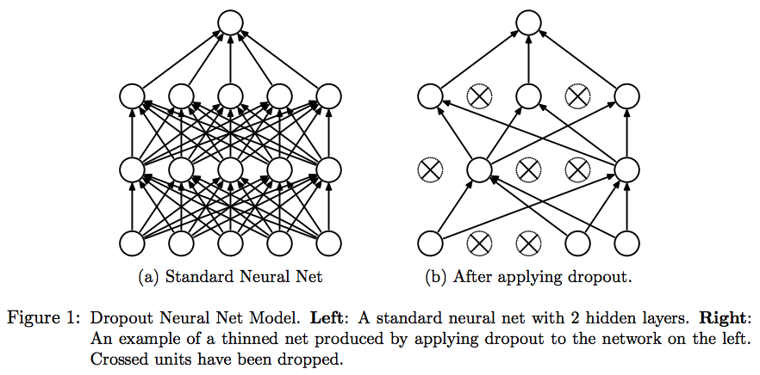
Dropout

Slide 26
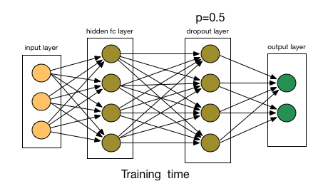
Dropout

Slide 27
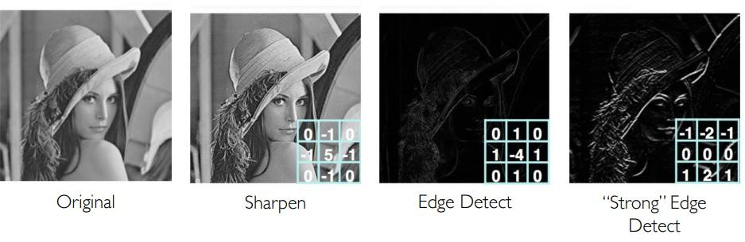
Feature maps
27
22-05-2022

Slide 28


one filter =>
one activation map
example 5x5 filters
(32 total)
We call the layer convolutional because it is related to convolution of two signals:
element-wise multiplication and sum of a filter and the signal (image)
Figure copyright Andrej Karpathy.

Slide 29



3D Convs and CNN-RNN Stack
For analyzing videos using neural networks, two types of architectures are used commonly
3D convolutional network it’s a natural extension to the 2D convolutions you are already familiar with. Just like in 2D conv, you move the filter in two directions (x and y), in 3D conv, you move the filter in three directions (x, y and z).
the standard CNN + RNN architecture in which you pass the images of a video through a CNN which extracts a feature vector for each image, and then pass the sequence of these feature vectors through an RNN
29
22-05-2022

Slide 30



3D convolutional network
In the case of 3D convolutions, the kernel that is used to perform convolutions on the image or the feature map has an additional dimension namely depth.
The kernel performs convolutions by moving in all three dimensions that is x, y, and z-axis. The third
dimension is considered to be time as 3D convolutions are used mostly for video classification.
https://towardsdatascience.com/counting-no-of-parameters-in-deep-learning-models-by-hand-8f1716241889
30
22-05-2022

Slide 31



Slide 32



Slide 33

Convolutions + RNN
The conv2D network will extract a feature vector for each image, and a sequence of these feature vectors is then fed to an RNN-based network. The output of the RNN is a regular softmax (for a classification problem such as this one).
Input with spatial structure, like images, cannot be modeled easily with the standard RNN.
Input
CNN
GRU
Dense
Dense
The CNN RNN(GRU) is an RNN architecture specifically designed for sequence prediction problems with spatial inputs, like images or videos.
it is natural to use a CNN as an image “encoder”, by first pre-training it for an image classification task and using the last hidden layer as an input to the RNN decoder which will capture the information hidden in the sequence of the images
33
22-05-2022

Slide 34


TimeDistributed
This wrapper applies a layer to every temporal slice of an input.
The input should be at least 3D, and the dimension of index one will be considered to be the temporal dimension.
Consider a batch of 32 samples, where each sample is a sequence of 10 vectors of 16 dimensions. The batch input shape of the layer is then (32, 10, 16), and the input_shape, not including the samples dimension, is (10, 16).
You can then use TimeDistributed to apply a Dense layer to each of the 10 timesteps, independently:
The output will then have shape (32, 10, 8).
https://keras.io/layers/wrappers/
34
22-05-2022

Slide 35



Slide 36


What is RNN
Recurrent Neural Networks (RNNs) add an interesting twist to basic neural networks. A vanilla neural network takes in a fixed size vector as input which limits its usage in
situations that involve a ‘series’ type input with
no predetermined size.
RNNs are designed to take a series of input
with no predetermined limit on size.
36
22-05-2022

Slide 37

RNN
w : weight matrix b : bias
37
22-05-2022

Slide 38


Challenges with training an RNN
RNN uses backpropagation algorithm, but for every timestep (Backpropagation through time[BTT])
when the gradients are bigger than 1.The updated values become so big to use it for optimizing. This is called exploding gradients.
when the gradients are smaller than 1. If we keep multiplying the values lower than 1, the result becomes smaller and smaller. After some steps, there will be no significant difference in outcome, and it can’t make any update in weights. It is called vanishing gradients.
https://d2l.ai/chapter_recurrent-neural-networks/bptt.html
38
22-05-2022

Slide 39

Challenges with training an RNN
Let’s take an example of text generation use-case
Input-sequence : “I grew up in France,…….. I speak French fluently”.
We can see from the example above that for the RNN to predict the word “French” which comes at the end of the sequence, it would need information from the word “France”, which occurs further back at the beginning of the sentence.
Unfortunately, in practice as this distance becomes wider, RNNs have a hard time learning these dependencies because it encounters either a vanishing or exploding gradient problem.
39
22-05-2022

Slide 40


Slide 41


How to fix this?
We can’t remember too many things so Instead of dragging all the past, maybe it’ll be better to remember
selectively.
This is like choosing only the important information and forgetting the rest. Having all those past values causes the vanishing gradients. Therefore we’ll give an additional step to simple RNN, which is exactly what’s done in GRU’s & LSTM’s
41
22-05-2022

Slide 42


Gates
These gates can learn which data in a sequence is important to keep or throw away. By doing that, it can pass relevant information down the long chain of sequences to make predictions.
Almost all state-of-the-art results based on recurrent neural networks are achieved with these two networks (LSTM’s and GRU’s).
42
22-05-2022

Slide 43



Let’s recall how RNN works
An RNN works like this; First words get transformed into machine-readable vectors. Then the RNN processes the sequence of vectors one by one
While processing, it passes the previous hidden state to the next step of the sequence.The hidden state acts as the neural networks memory. It holds information on previous data the network has seen before.
43
22-05-2022

Slide 44


LSTM
The core concept of LSTM’s are the cell state, and it’s
various gates
The cell state act as a transport highway that transfers relative information all the way down the sequence chain. You can think of it as the “memory” of the network.The cell state, in theory, can carry relevant information throughout the processing of the sequence. So even
information from the earlier time steps can make it’s way to later time steps, reducing the effects of short-term memory.As the cell state goes on its journey, information
get’s added or removed to the cell state via gates.The gates are different neural networks that decide which information is allowed on the cell state.The gates can learn what information is relevant to keep or forget during training.
44
22-05-2022

Slide 45


Forget Gate
This gate decides what information should be thrown away or kept.
Information from the previous hidden state and information from the current input is passed through the sigmoid function.Values come out between 0 and 1.
The closer to 0 means to forget, and the closer to 1 means to keep.
45
22-05-2022

Slide 46


Input Gate
To update the cell state, we have the input gate.
First, we pass the previous hidden state and current input into a sigmoid function.That decides which values will be updated by transforming the values to be between 0 and
1. 0 means not important, and 1 means important.
We also the hidden state and current input into the tanh function which returns a value between -1 and 1 to help regulate the network.Then you multiply the tanh output with the sigmoid output.
The sigmoid output will decide which information is
important to keep from the tanh output.
46
22-05-2022

Slide 47


Output Gate
The output gate decides what the next hidden
state should be.
First, we pass the previous hidden state and the
current input into a sigmoid function.
Then we pass the newly modified cell state to the tanh function.We multiply the tanh output with the sigmoid output to decide what information the hidden state should carry.
The output is the hidden state.The new cell state and the new hidden is then carried over to the next time step.
47
22-05-2022

Slide 48


LSTM
48
22-05-2022

Slide 49


GRU
The GRU is the newer generation of Recurrent Neural networks and is pretty similar to an LSTM. GRU’s got rid of the cell state and used the hidden state to transfer information. It also only has two gates, a reset gate and update gate.
Update Gate
Similar to Forget gate in LSTM networks
Reset Gate
The reset gate is another gate is used to decide how
much past information to forget.
49
22-05-2022

Slide 50

GRU
50
22-05-2022

Slide 51


#LifeKoKaroLift
Thank You!
51
22-05-2022

